Slide 2
Regression

Slide 3
Regression vs. Classification
Given x, will y ≥ 4?
Given x, what is y?

Slide 4
Which to use and when?
Classification
Predicting class membership
Is this classical music or death metal?
Predicted label(s) should be interpretable as probabilities
Will a user click on this content?
There is no particular order to the label(s)
What species of dog is this?
Regression
The values are continuous
Predicting the sale price of a home
Values are discrete, but have meaning
How many stars will this movie earn on IMDB?
Distance from the true value matters

Slide 5
A Little Bit Of History
19 observations over three days in January of 1801
Using just three of the observations, Legendre sucesfully predicted Ceres’ next location.
commons.wikimedia.org
books.google.com

Slide 6
Evaluation Metrics
Don’t always have a asteroid to confirm predictions
Classification metrics boil down to “was the prediction right?”
ROC Curves
Precision vs Recall
F1 Score
Loss
Regression are continuous
Quantify how right they are over how many inputs:
Mean Absolute Error:
Σ(y_{true} – y_{pred})
Root-Mean Square
Sqrt(1/n Σ(y_{true} – y_{pred})²)
Goodness-of-fit
Σ(y_{true} – y_{pred})²/y_{pred}

Slide 7
Algorithm Zoo
As with classification, there is a panoply of possible algorithms you can apply to the problem.
Typically trading off model complexity, training time, and risk of over-training
Some of the most common regression techniques include:
Linear regression
Polynomial regression
Ridge
Lasso

Slide 8
Linear Regression
Assumes 1st order relationship between input features and output value
y_{pred} = Σβ_{i}x_{i}
Loss function often minimized using the “least squares” method (or singular value decomposition)
E = Σ(y_{true} – y_{pred})² = Σ(y_{true} – Σβx)²

Slide 9
Polynomial Regression
Higher order relationships can be included by creating “cross-terms”
Linear Model with two features (a, b):
Y_{pred} = β₀ + β₁a + β₂b
Polynomial Model:
y_{pred} = β₀ + β₁a + β₂b + β₃a² + β₄b² + β₅ab

Slide 10
Tradeoffs
Pros:
Fast to train
Results are interpretable
Multiply inputs by coefficients of a given record to understand the prediction
Can be updated without retraining from scratch
Cons:
Susceptible to over-training
Especially when the input features are correlated
Has a tendency to focus on the means of the distribution

Slide 11
Lasso and Ridge
Critical extensions to linear regression that penalize large coefficients
Lasso:
L1 norm
E = Σ(y_{true} – Σβx)² + λΣ|β_{i}|
Generate as many zero coefficients as possible
Model size is drastically reduced
Ridge:
L2 norm
E = Σ(y_{true} – Σβx)² + λΣ|β_{i}²|
Generate small and relatively uniform coefficients
Can allow more robustness in the model

Slide 12
Data Quality Matters!
Regressions can be very sensitive to “bad” data
Noise in the measurement
Unit conversion errors
Null values

Slide 13
Data Quality Matters!
Regressions can be very sensitive to “bad” data
Noise in the measurement
Unit conversion errors
Null values

Slide 14
Data Quality Matters!
Regressions can be very sensitive to “bad” data
Noise in the measurement
Unit conversion errors
Null values

Slide 15
Data Quality Matters!
Regressions can be very sensitive to “bad” data
Noise in the measurement
Unit conversion errors
Null values

Slide 16
Data Quality Matters!
Several fixes, depending on use case:
Filter out outliers
Give default value (e.g. mean)

Slide 17
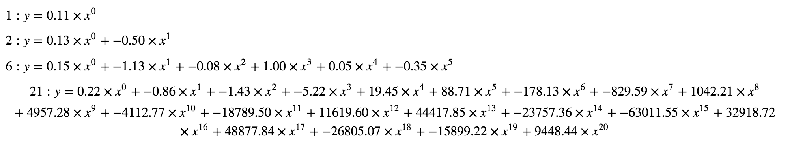
Over-fitting and Under-fitting
Not the same as outliers
Problem when data is sparse and/or number of features is big
Model complexity yields more nuanced predictions
Susceptible to over-fitting.
Polynomial Regression

Slide 18
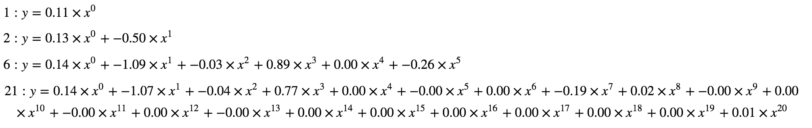
Over-fitting and Under-fitting
Not the same as outliers
Problem when data is sparse and/or number of features is big
Model complexity yields more nuanced predictions
Susceptible to over-fitting.
Ridge Regression

